Slide 1


Tim Hoogenboom
May 6, 2025

Slide 2
Table of Contents
Executive Summary
Introduction
Methodology
Results
Conclusion
Appendix
Tim Hoogenboom | IBM Data Science Capstone | May 5, 2025 | 2

Slide 3
Executive Summary
Summary of methodologies
Data Collection via SpaceX API and web scraping of Wiki
Data Wrangling to add label launch success or launch failure
Data Analysis to query dataset and better understand content
Data Exploration to graphically visualize relation between variables launch site, payload mass, orbit type, years, and success rate, and spatially visualize relation between launch site, success, and proximity to objects
Data dashboarding to visualize relation between launch site, payload mass, and success rate
Predictive modelling via LR, SVM, decision tree, and KNN to understand scoring accuracy
Summary of results
Data Exploration Success rate increases by each year launching independent of launching site,
Predictive Modelling Decision Tree Model has the highest accuracy 87% accuracy (compared to 83% of the other models) of successful landing of the first stage rocket booster.
Herewith competitor Space Y can make more informed bids.
Tim Hoogenboom | IBM Data Science Capstone | May 5, 2025 | 3

Slide 4
Introduction
Background
SpaceX advertises Falcon 9 rocket launches on its website with a cost of 62 million dollars; other providers cost upward of 165 million dollars each, much of the savings is because SpaceX can reuse the first stage. Therefore, if we can determine if the first stage will land, we can determine the cost of a launch. This information can be used if an alternate company wants to bid against SpaceX for a rocket launch.
Therefor we want to understands better if we can predict if a SpaceX rocket will land successfully after the first stage and what factors affect it.
Problem Statement
The following questions will be further investigated
Understand what variables affect successful launch outcome
Identify ML model scores highest accuracy on predicting new launch outcome (landing/not landing first stage)
Tim Hoogenboom | IBM Data Science Capstone | May 5, 2025 | 4

Slide 5

Section 1

Slide 6
Methodology
Executive Summary
Data Collection via SpaceX API (data1, Github) and web scraping of Wiki (data2, Github)
Data Wrangling to reformat launch sites, orbit types and add label launch success or launch failure via IBM dataset (data3, Github)
Data Analysis to query dataset and better understand content via IBM dataset (data4, Github)
Data Exploration to graphically visualize relation between variables launch site, payload mass, orbit type, years, and success rate via IBM dataset (data5, Github), and spatially visualize relation between launch site, success, and proximity to objects via IBM dataset (data6, Github)
Data dashboarding to visualize relation between launch site, payload mass, and success rate via IBM dataset (data7, python, Github)
Predictive modelling via LR, SVM, decision tree, and KNN to understand scoring accuracy via IBM dataset (data5, Github)
Tim Hoogenboom | IBM Data Science Capstone | May 5, 2025 | 6

Slide 7
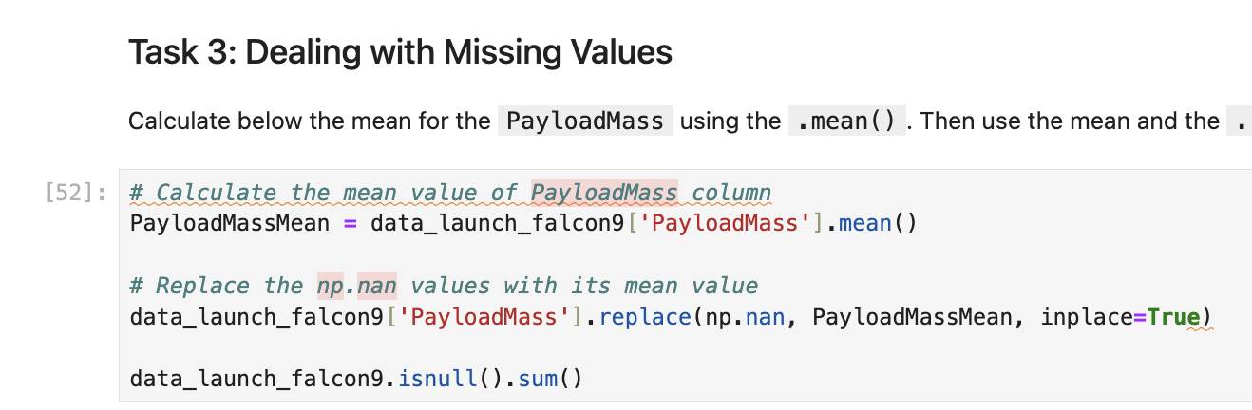
Data Collection
What
Data Collection via SpaceX API (data1, Github)
How
Request data via API via GET request
Turn json response into dataframe
Extract subset of columns into new dataframe
Remove ‘Falcon 1’ launches from dataframe
Wrangle Payload data by replacing missing values with mean values
Tim Hoogenboom | IBM Data Science Capstone | May 5, 2025 | 7

Slide 8
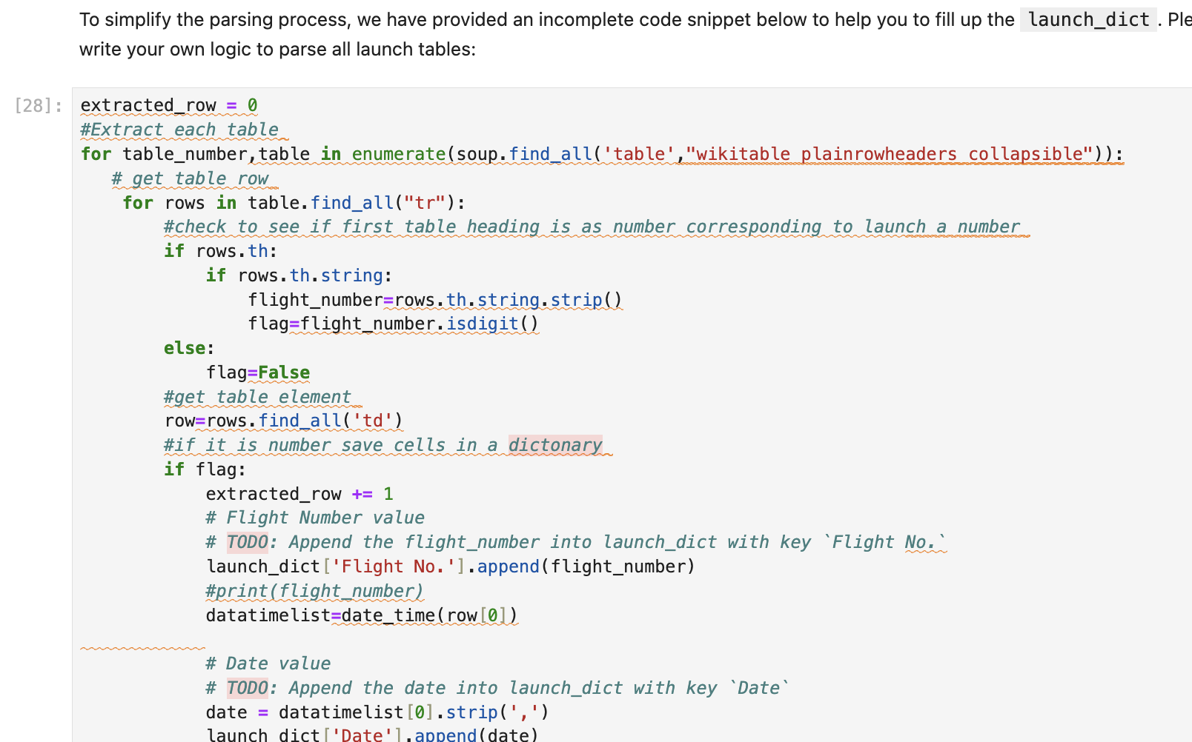
Web Scraping
What
Web scraping of Wiki (data2, Github)
How
Request Falcon9 Launch HTML page as an HTTP response via HTTP get
Create Beautiful soup object
Extract HTML headers as column names
Create dataframe based on column names and HTML table
Tim Hoogenboom | IBM Data Science Capstone | May 5, 2025 | 8

Slide 9
Web Scraping
What
Web scraping of Wiki (data2, Github)
How
Request Falcon9 Launch HTML page as an HTTP response via HTTP get
Create Beautiful soup object
Extract HTML headers as column names
Create dataframe based on column names and HTML table
Tim Hoogenboom | IBM Data Science Capstone | May 5, 2025 | 9

Slide 10
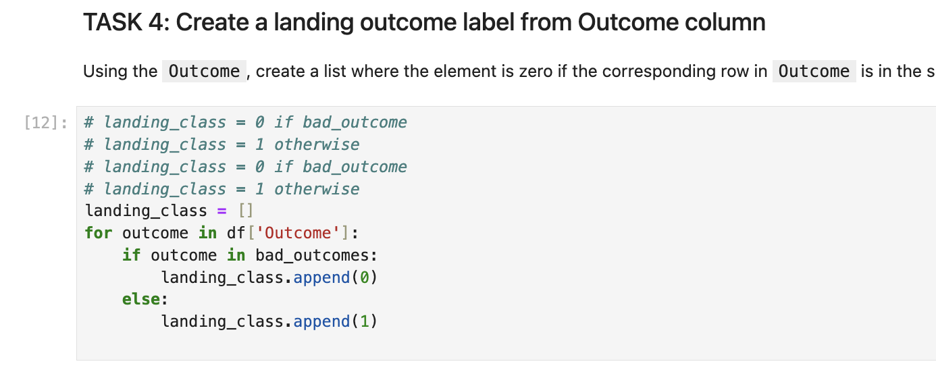
Data Wrangling
What
Data Wrangling to reformat launch sites, orbit types and add label launch success or launch failure via IBM dataset (data3, Github)
How
Fetch external data set in dataframe
Count number of launches per Launch_Site
Count number of Orbits
Count number of Outcomes and label into Successful [1] or Bad [0] in dataframe
Combine dataframes
Tim Hoogenboom | IBM Data Science Capstone | May 5, 2025 | 10
Notes:
C

Slide 11
Data Visualization
What
Data Exploration to graphically visualize relation between variables launch site, payload mass, orbit type, years, and success rate via IBM dataset (data5, Github)
How
Fetch external data set in dataframe
Count number of launches per Launch_Site
Count number of Orbits
Count number of Outcomes and label into Successful [1] or Bad [0] in dataframe
Combine dataframes
Tim Hoogenboom | IBM Data Science Capstone | May 5, 2025 | 11
Notes:
C

Slide 12
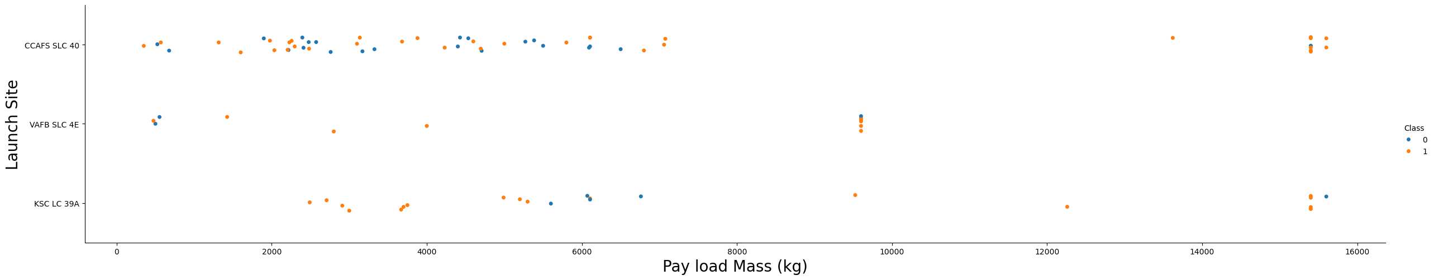
Data Visualization Payload Mass vs. Launch Site
What
There appears to be no correlation between Payload Mass and Launch Site.
Illustration
Tim Hoogenboom | IBM Data Science Capstone | May 5, 2025 | 12
Notes:
C

Slide 13
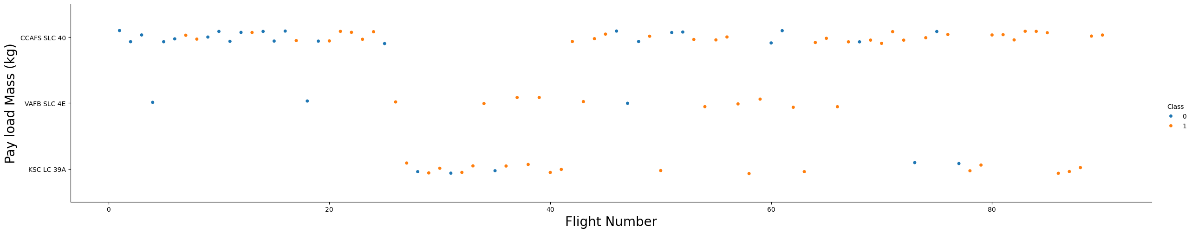
Data Visualization Flight Number vs. Launch Site
What
As the flight number increases, the first stage is more likely to land successfully independent of the Launch_site.
Illustration
Tim Hoogenboom | IBM Data Science Capstone | May 5, 2025 | 13
Notes:
C

Slide 14
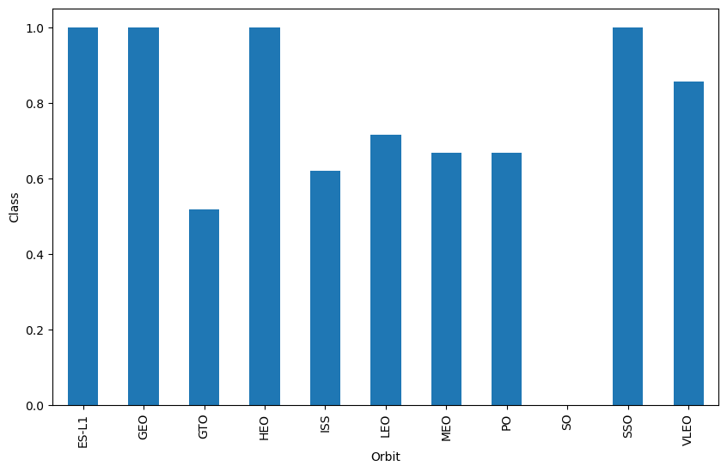
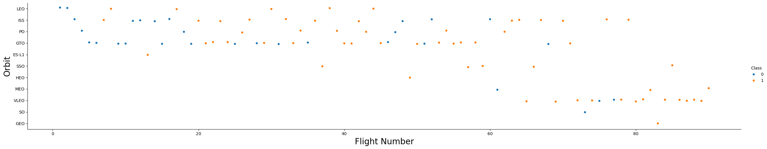
Data Visualization Success Rate vs. Orbit Type (bar chart) and Flight Number vs. Orbit Type
What
Orbits ES-L1, GEO, HEO, SSO, VLEO have the highest average success in Launch_Outcome based on a the Bar Chart, but for orbit GEO, HEO, ES-L1 only one flight was executed so less statically relevant.
Illustration
Tim Hoogenboom | IBM Data Science Capstone | May 5, 2025 | 14
Notes:
C

Slide 15
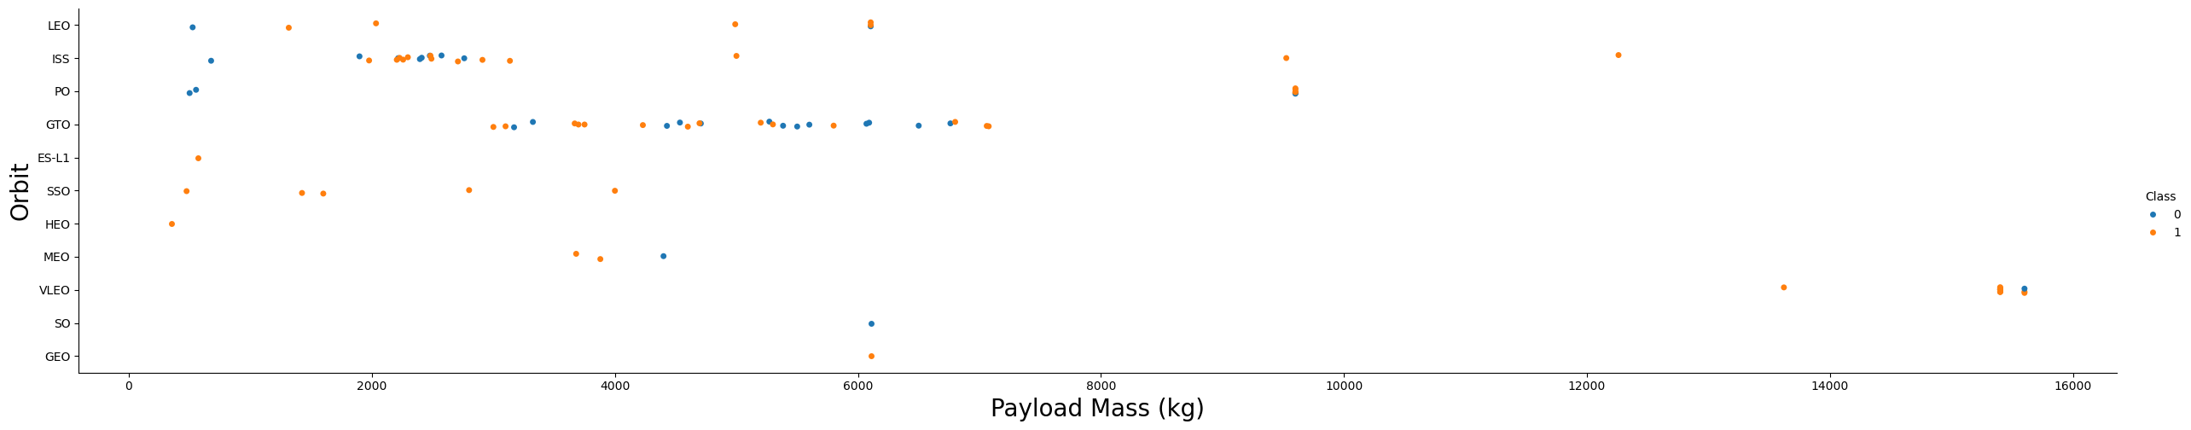
Data Visualization Payload vs. Orbit Type
What
With heavy payloads the successful landing or positive landing rate are more for Polar,LEO and ISS.
However, for GTO, it's difficult to distinguish between successful and unsuccessful landings as both outcomes are present.
Illustration
Tim Hoogenboom | IBM Data Science Capstone | May 5, 2025 | 15
Notes:
C

Slide 16
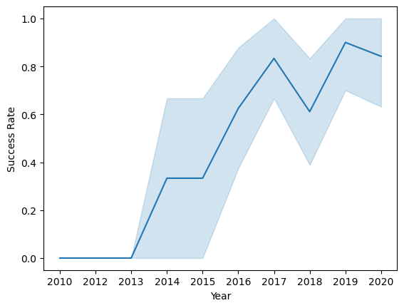
Data Visualization Launch Success Yearly Trend
What
General conclusion is that the success rate of Launch_Outcome appears to increase over the years that flights are executed.
Illustration
Tim Hoogenboom | IBM Data Science Capstone | May 5, 2025 | 16
Notes:
C

Slide 17
Data Exploration
What
Data Exploration to spatially visualize relation between launch site, success, and proximity to objects via IBM dataset (data6, Github)
How
Fetch external data set in dataframe
Extract Launch_Site coordinates and create Map Objected (marker)
Mark Launch_Site on Folium geospacial map
Add Success [1] and Failed [1] missions per Launch_Site
Calculate distance and visualize PolyLine between Launch_Site and selected markers in the vicinity
Hereafter one can coclude that Launch Sites are close to railways, highways and coastline and away from cities
Tim Hoogenboom | IBM Data Science Capstone | May 5, 2025 | 17
Notes:
C

Slide 18
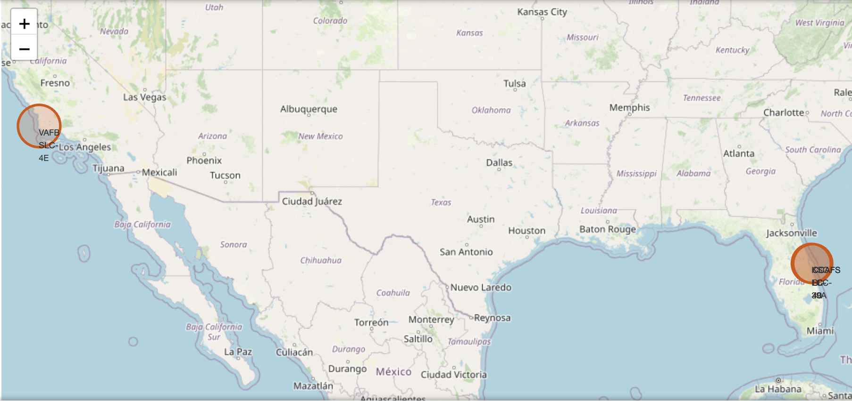
Data Exploration
What
Explore the generated folium map and make a proper screenshot to include all launch sites’ location markers on a global map
Illustration
Tim Hoogenboom | IBM Data Science Capstone | May 5, 2025 | 18
Notes:
C

Slide 19
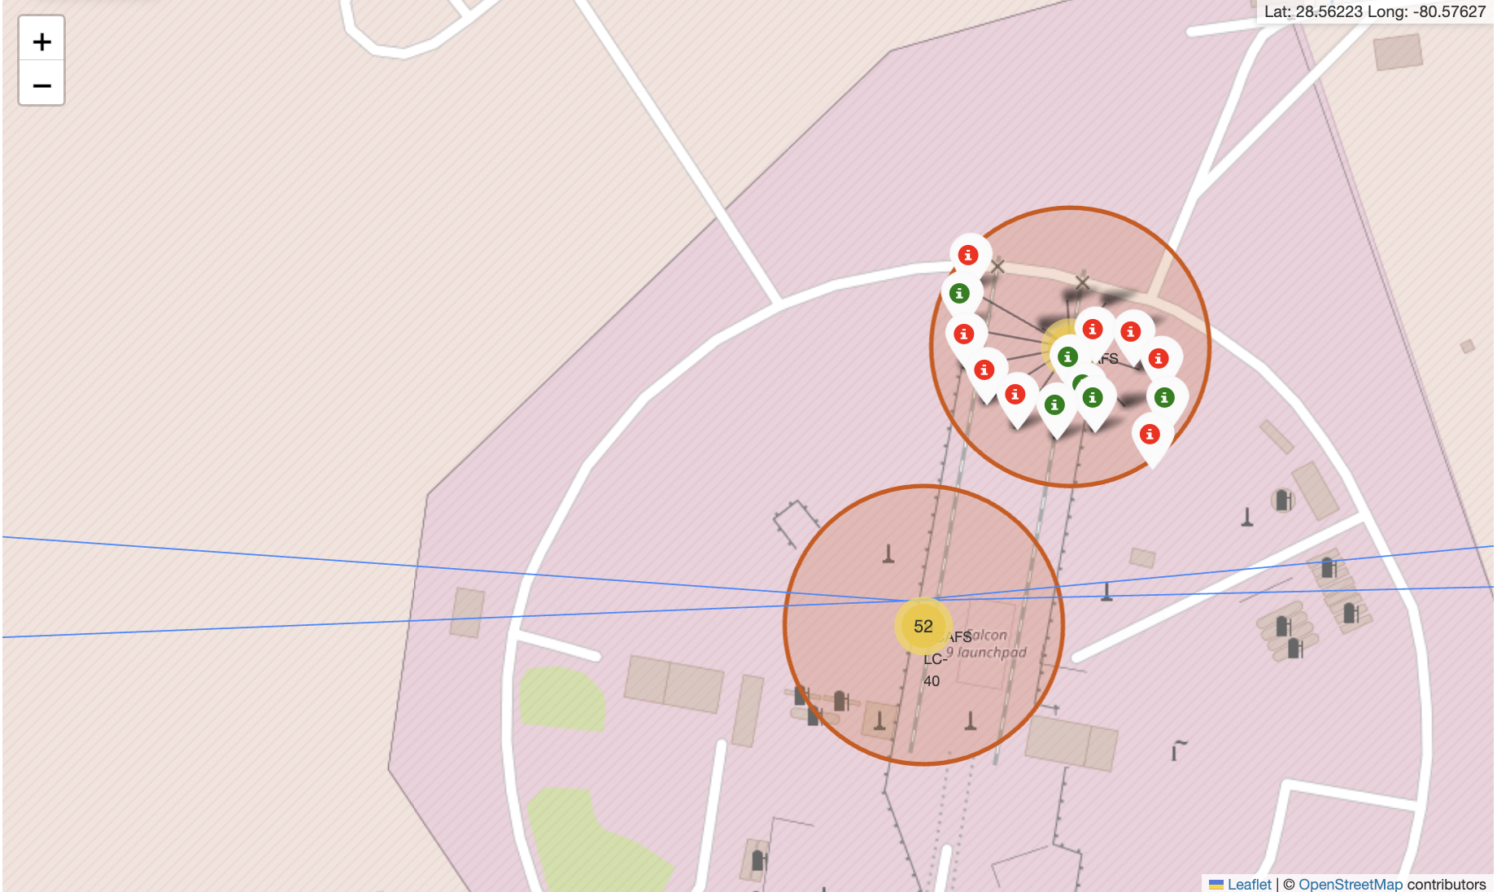
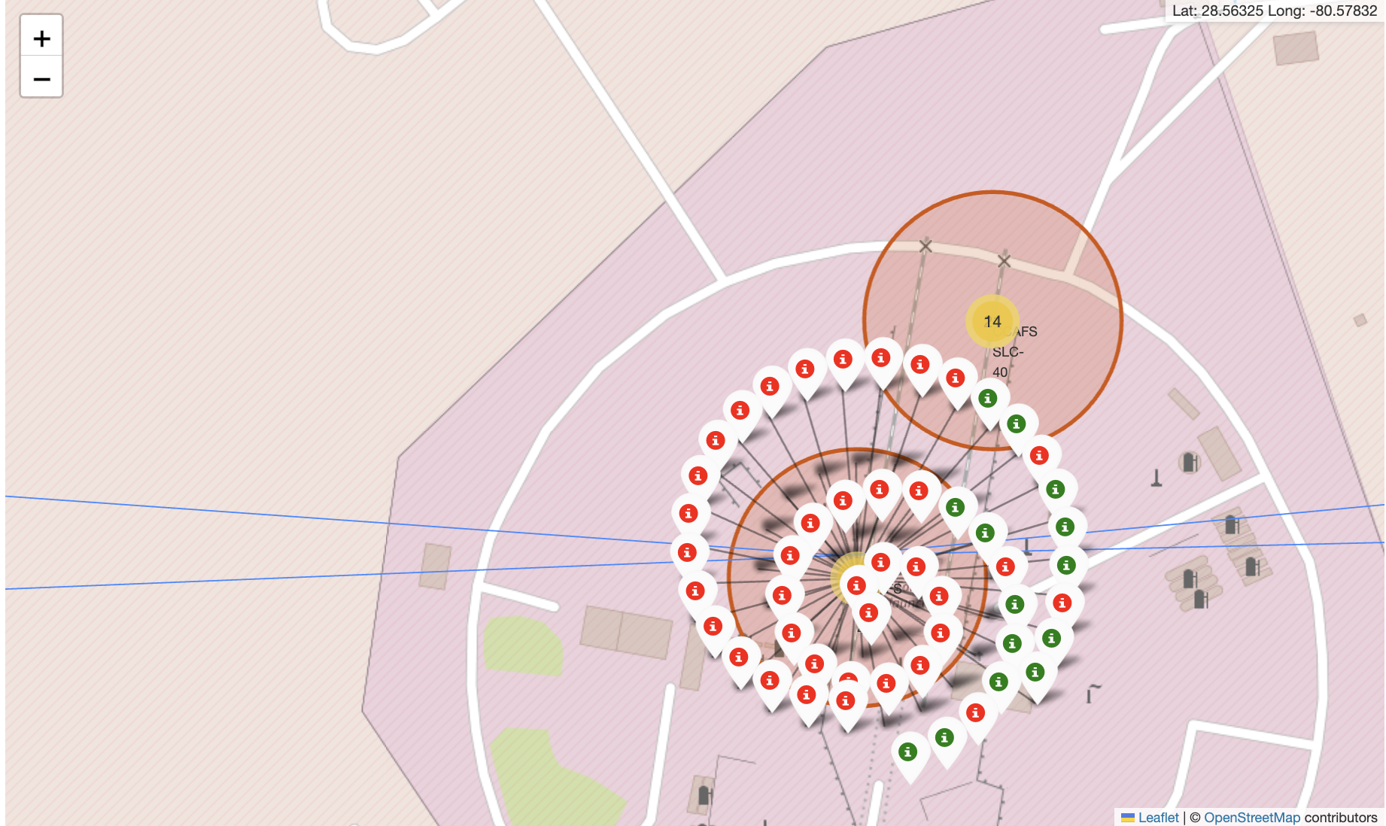
Data Exploration
What
Visualization per Launch_Site based on all launch records if a launch was successful [1, green marker] or failure [0, red marker]
Illustration
Tim Hoogenboom | IBM Data Science Capstone | May 5, 2025 | 19
Notes:
C

Slide 20
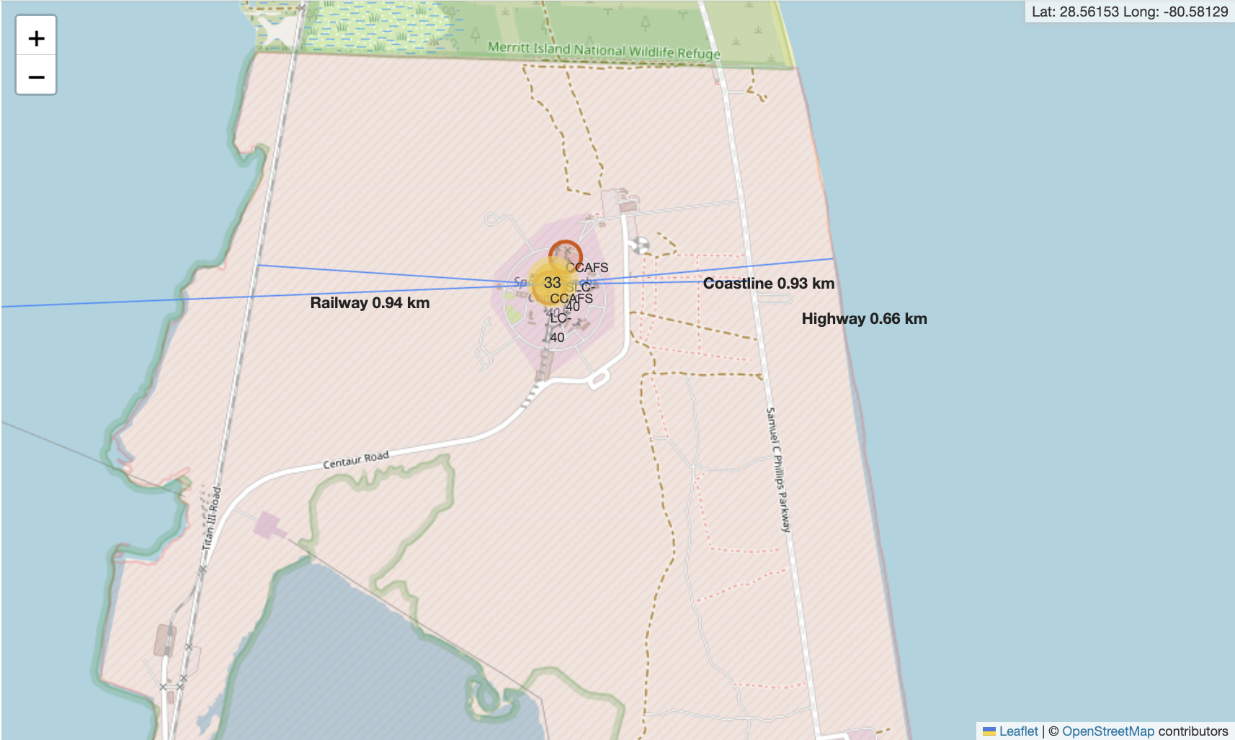
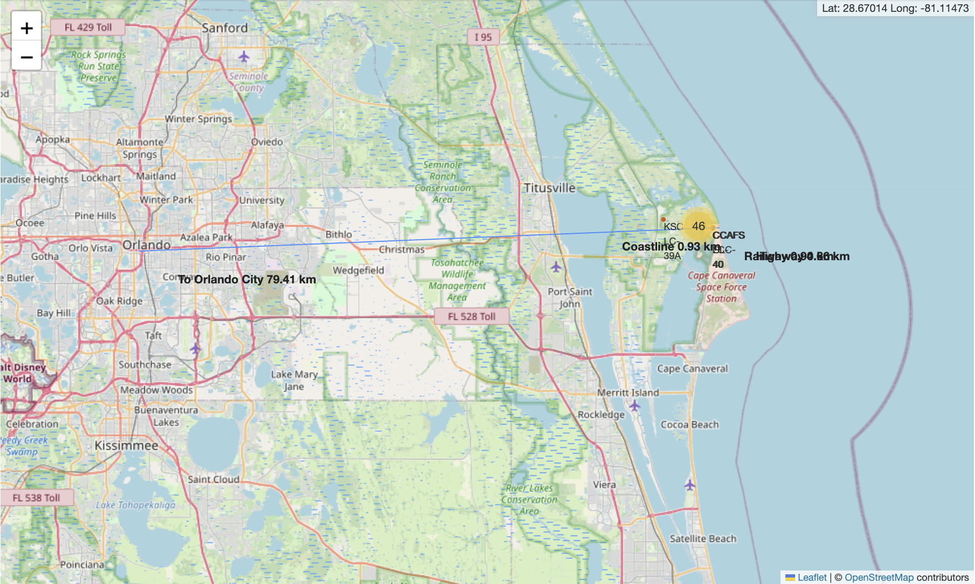
Data Exploration
What
General conclusion is Launch_Sites are always in close proximity to any railway, highway, coastline, etc.
General conclusion is Launch_Sites are always in remote areas away from cities and close to equator for favorable most weather conditions sun/clear skies.
Illustration
Tim Hoogenboom | IBM Data Science Capstone | May 5, 2025 | 20
Notes:
C

Slide 21
Data Analysis with SQL
What
Data Analysis to query and undertstand dataset and better understand content via IBM dataset (data4, Github)
How
Load external data set into SQL DB and query via MagicSQL.
Not working for me so credits fly out to Raegan Tysh for sharing a workaround!!!
Execute SQL queries to understand DISTINCT Launch_Site, AVERAGE payload_Mass, Boosters within certain limits, etc.
Execute SQL queries to understand COUNT of successful Mission_Outcome and RANK successful Mission_Outcomes, etc.
Tim Hoogenboom | IBM Data Science Capstone | May 5, 2025 | 21
Notes:
, etcC

Slide 22
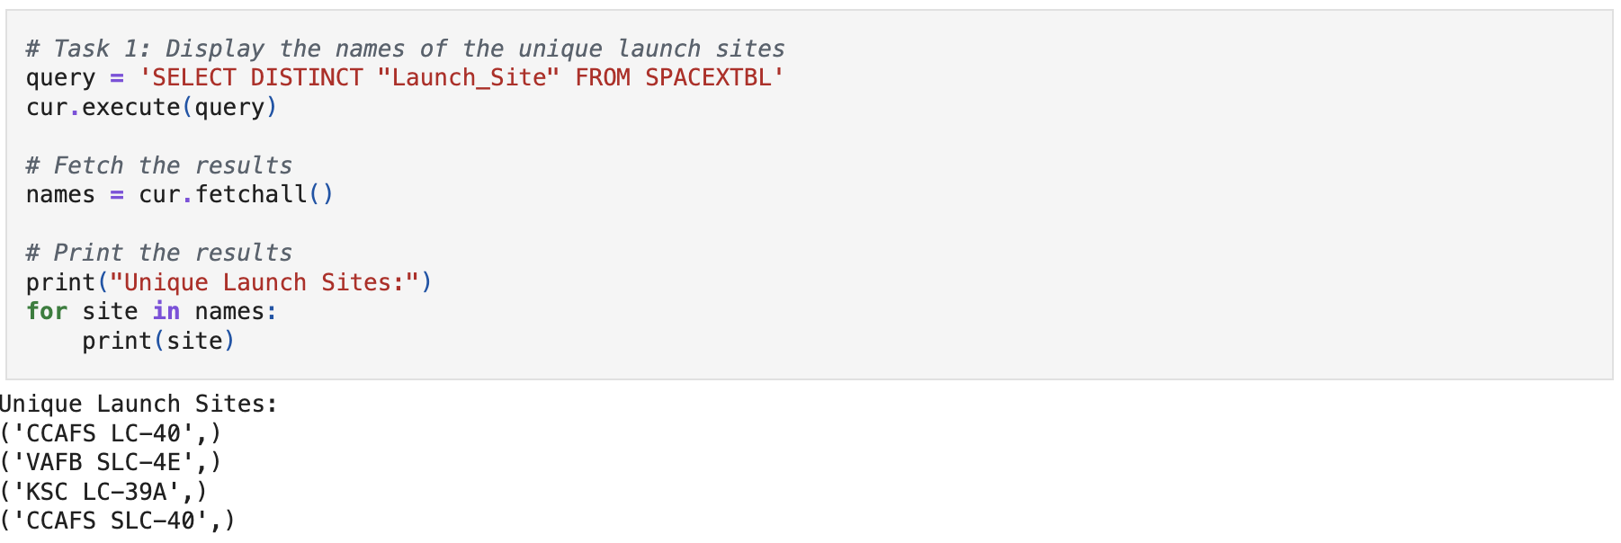
Data Analysis with SQL All Launch Site Names
What
Find the names of the unique launch sites
Present your query result with a short explanation here
Illustration
Tim Hoogenboom | IBM Data Science Capstone | May 5, 2025 | 22
Notes:
, etcC

Slide 23
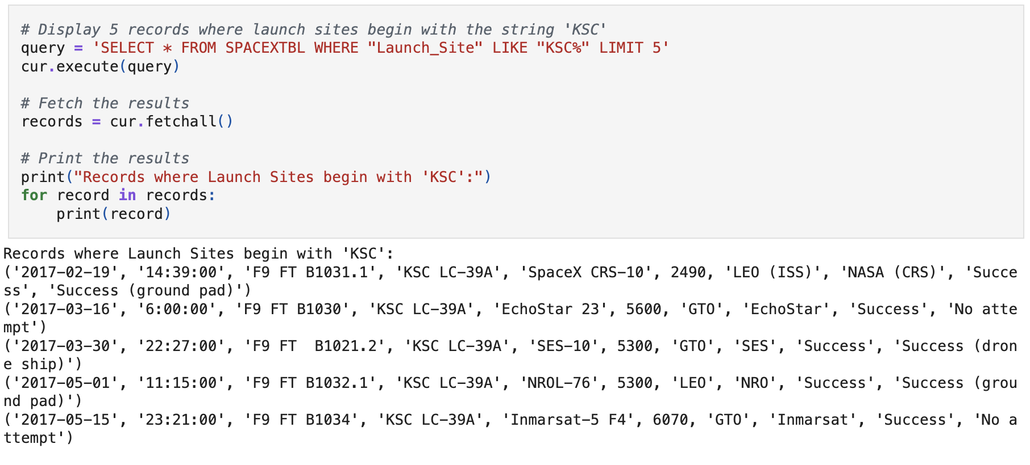
Data Analysis with SQL Launch Site Names Begin with 'KSC'
What
Find 5 records where launch sites’ names start with `KSC`
Present your query result with a short explanation here
Illustration
Tim Hoogenboom | IBM Data Science Capstone | May 5, 2025 | 23
Notes:
, etcC

Slide 24
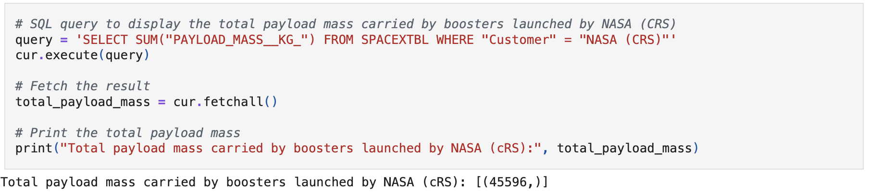
Data Analysis with SQL Total Payload Mass
What
Calculate the total payload carried by boosters from NASA
Present your query result with a short explanation here
Illustration
Tim Hoogenboom | IBM Data Science Capstone | May 5, 2025 | 24
Notes:
, etcC

Slide 25
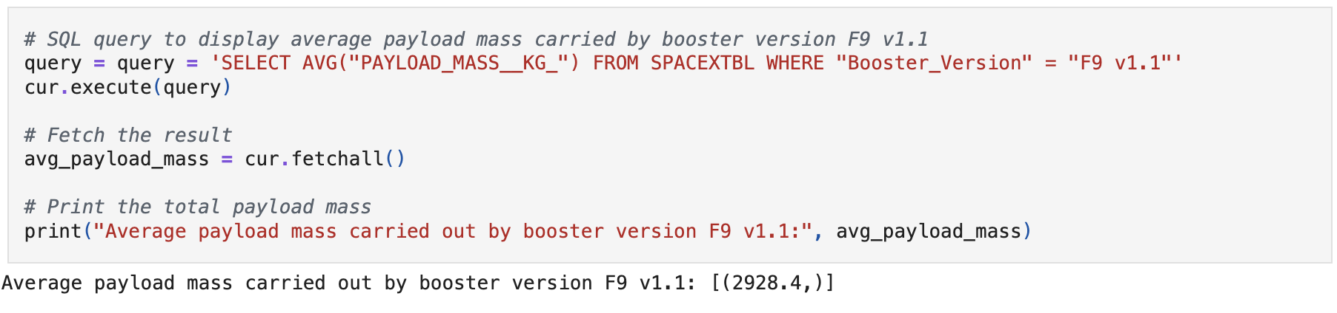
Data Analysis with SQL Average Payload Mass by F9 v1.1
What
Calculate the average payload mass carried by booster version F9 v1.1
Present your query result with a short explanation here
Illustration
Tim Hoogenboom | IBM Data Science Capstone | May 5, 2025 | 25
Notes:
, etcC

Slide 26
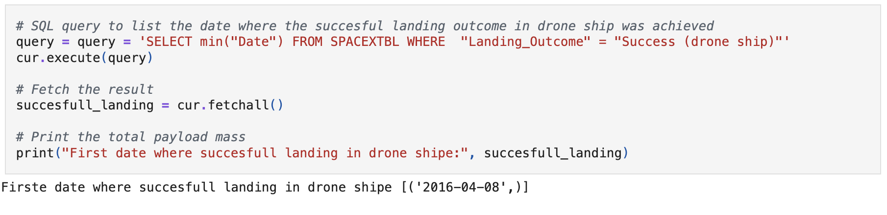
Data Analysis with SQL First Successful Ground Landing Date
What
Find the dates of the first successful landing outcome on drone ship.
Present your query result with a short explanation here
Illustration
Tim Hoogenboom | IBM Data Science Capstone | May 5, 2025 | 26
Notes:
, etcC

Slide 27
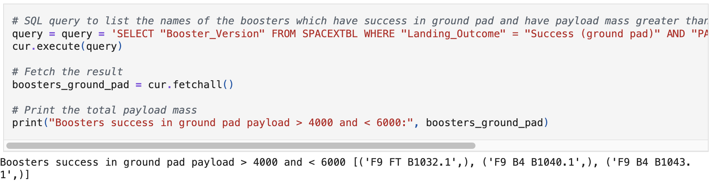
Data Analysis with SQL Successful Drone Ship Landing with Payload between 4000 and 6000
What
List the names of boosters which have successfully landed on drone ship and had payload mass greater than 4000 but less than 6000
Present your query result with a short explanation here
Illustration
Tim Hoogenboom | IBM Data Science Capstone | May 5, 2025 | 27
Notes:
, etcC

Slide 28
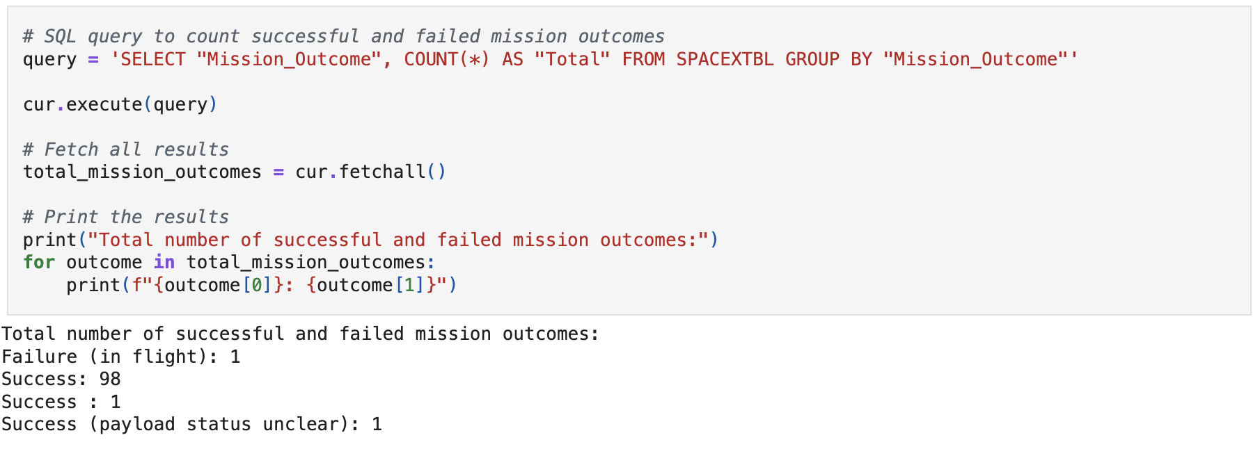
Data Analysis with SQL Total Number of Successful and Failure Mission Outcomes
What
Calculate the total number of successful and failure mission outcomes
Present your query result with a short explanation here
Illustration
Tim Hoogenboom | IBM Data Science Capstone | May 5, 2025 | 28
Notes:
, etcC

Slide 29
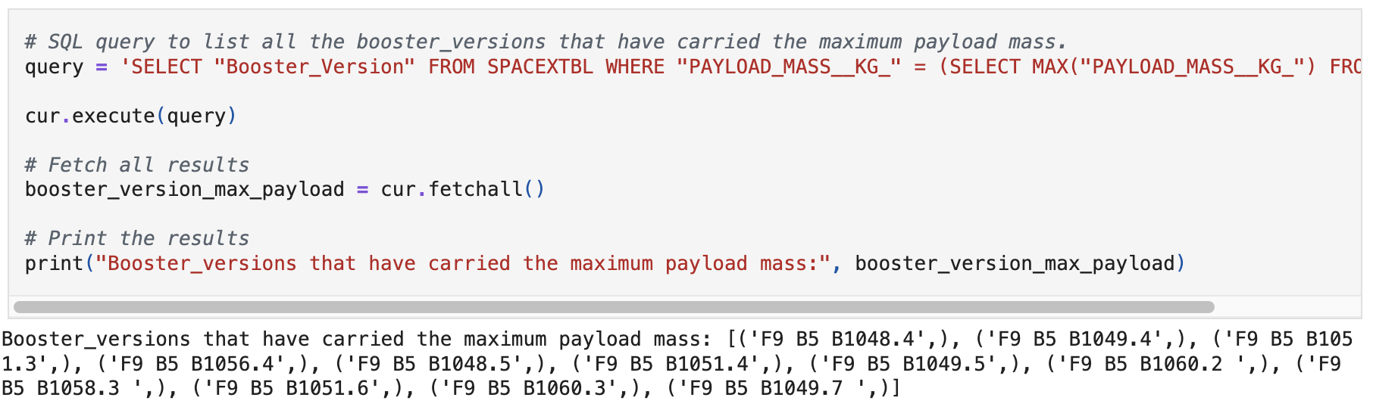
Data Analysis with SQL Boosters Carried Maximum Payload
What
List the names of the booster which have carried the maximum payload mass
Present your query result with a short explanation here
Illustration
Tim Hoogenboom | IBM Data Science Capstone | May 5, 2025 | 29
Notes:
, etcC

Slide 30
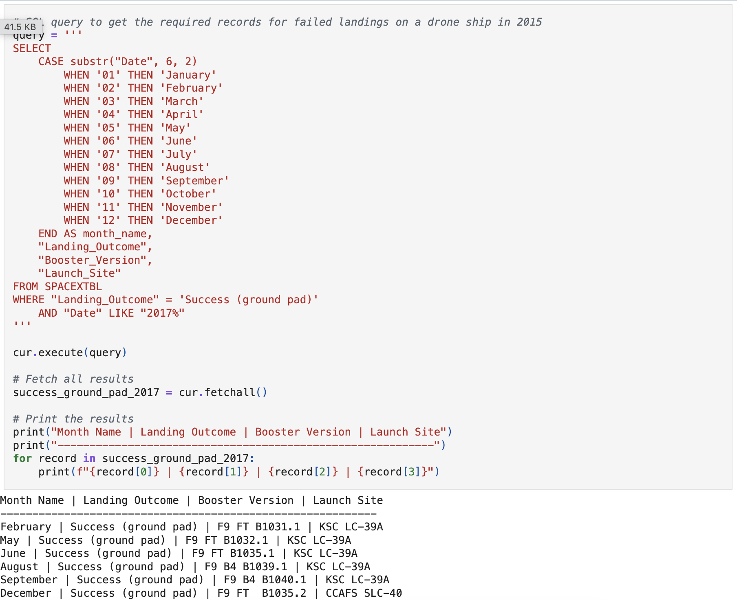
Data Analysis with SQL 2017 Launch Records
What
List the records which will display the month names, succesful landing_outcomes in ground pad ,booster versions, launch_site for the months in year 2017
Present your query result with a short explanation here
Illustration
Tim Hoogenboom | IBM Data Science Capstone | May 5, 2025 | 30
Notes:
, etcC

Slide 31
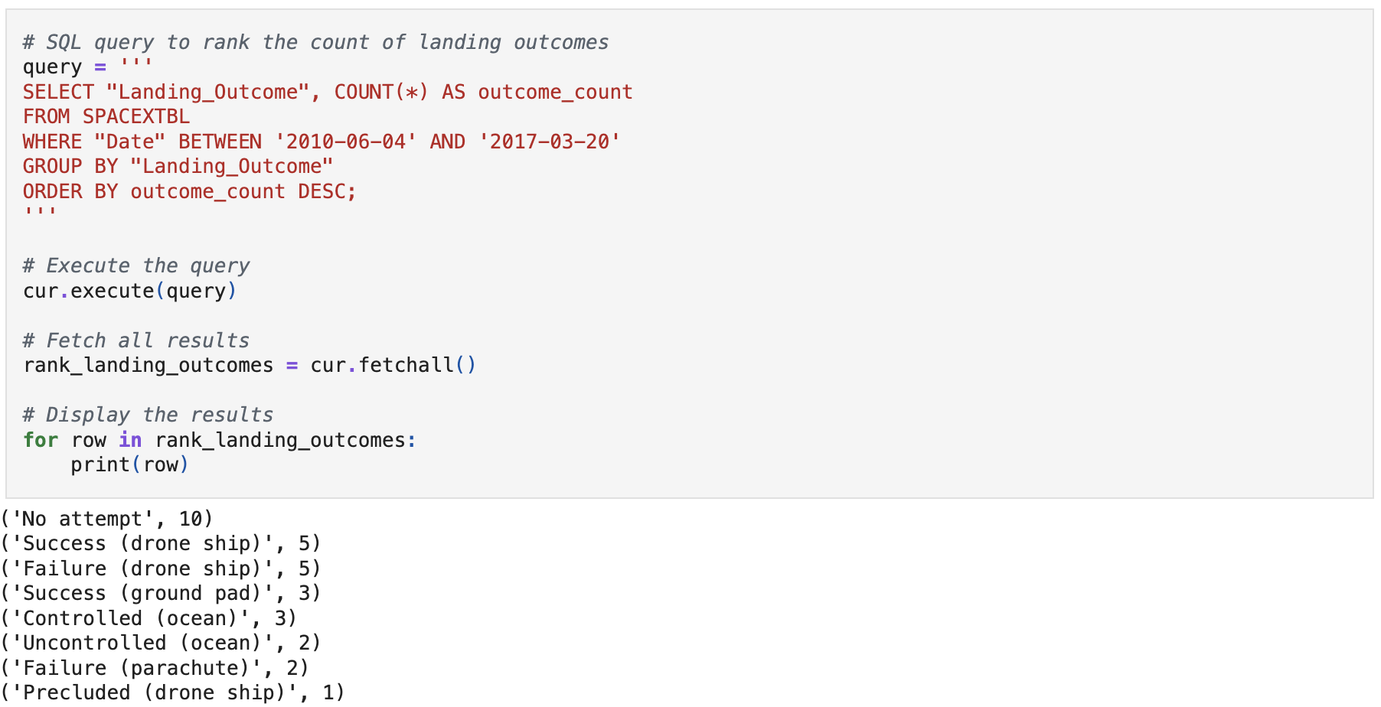
Data Analysis with SQL Rank Landing Outcomes Between 2010-06-04 and 2017-03-20
What
Rank the count of landing outcomes, such as Failure (drone ship) or Success (ground pad), between the date 2010-06-04 and 2017-03-20, in descending order
Present your query result with a short explanation here
Illustration
Tim Hoogenboom | IBM Data Science Capstone | May 5, 2025 | 31
Notes:
, etcC

Slide 32
Dashboarding with Ploty Dash
What
Data dashboarding to visualize relation between launch site, payload mass, and success rate via IBM dataset (data7, python, Github)
How
Add a Launch Site Drop-down Input Component
Add a callback function to render success-pie-chart based on selected site dropdown
Add a Range Slider to Select Payload
Add a callback function to render the success-payload-scatter-chart scatter plot
Tim Hoogenboom | IBM Data Science Capstone | May 5, 2025 | 32
Notes:
, etcC

Slide 33
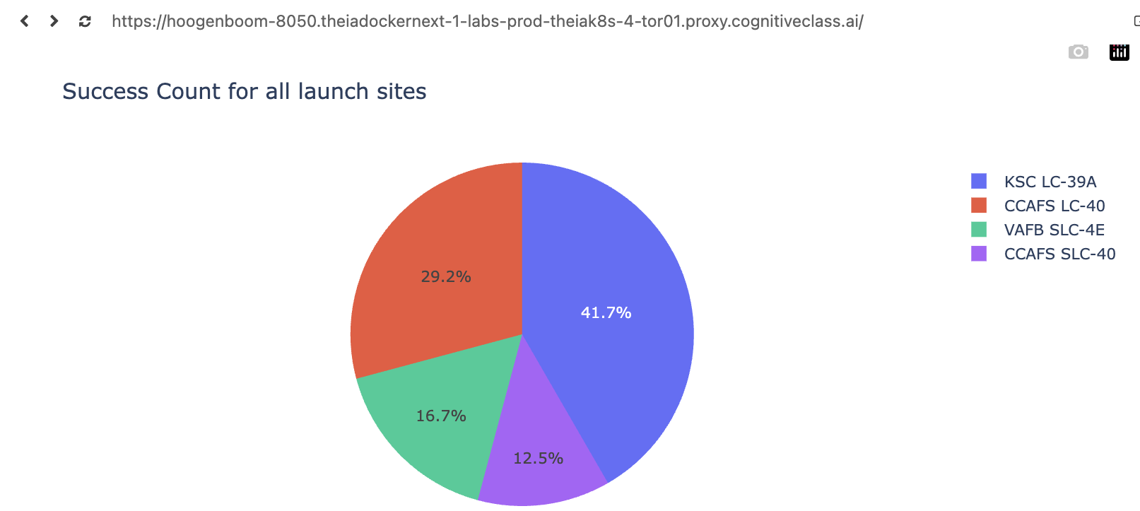
Dashboarding with Ploty Dash
What
Show the screenshot of launch success count for all sites, in a pie chart
Explain the important elements and findings on the screenshot
Illustration
Launch Site KSC LC-39A has highest count for successful launches
Tim Hoogenboom | IBM Data Science Capstone | May 5, 2025 | 33
Notes:
, etcC

Slide 34
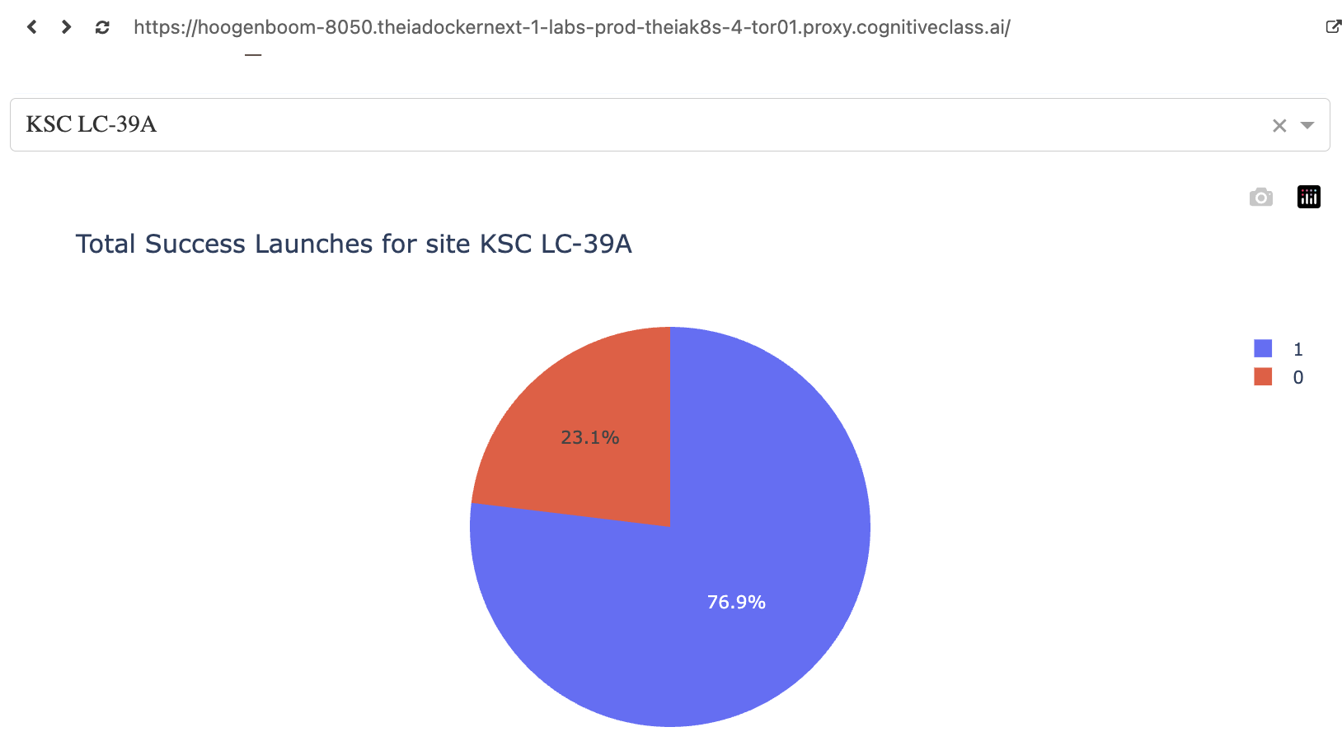
Dashboarding with Ploty Dash
What
Show the screenshot of the pie chart for the launch site with highest launch success ratio
Explain the important elements and findings on the screenshot
Illustration
Launch Site KSC LC-39A has highest share [76,9%] for successful [1] launches
Tim Hoogenboom | IBM Data Science Capstone | May 5, 2025 | 34
Notes:
, etcC

Slide 35
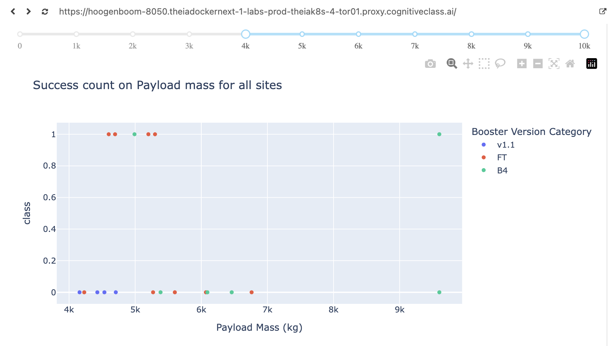
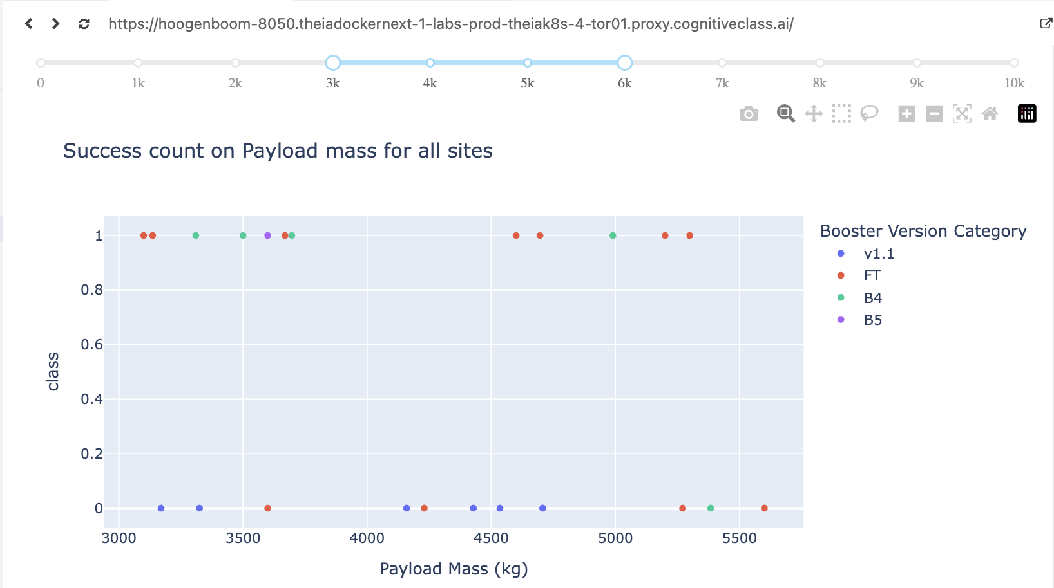
Dashboarding with Ploty Dash
What
Screenshots of Payload vs. Launch Outcome scatter plot for all sites, with different payload selected in range slider
Explain important elements and findings on screenshot, such as which payload range or booster version have largest success rate, etc.
Illustration
Booster Version FT has most successful [1] launches
Tim Hoogenboom | IBM Data Science Capstone | May 5, 2025 | 35
Notes:
, etcC

Slide 36
Predictive Analysis (Classification)
What
Predictive modelling via LR, SVM, decision tree, and KNN to understand scoring accuracy via IBM dataset (data5, Github)
How
Load external data set into dataframe
Standardized the data, split our data in training and test data (X – launch orbit details, Y – launch success or failure)
Built different Logistic Regression, SVM, Decision Tree, K-Nearest Neighbor machine learning models and tune different hyperparameters using GridSearch CV.
Identify most accurate classification machline learning model via Training Data (Decision tree)
Validate most accurate classification machine learning model on Test Data and illustrate via Confusion Matric FP/ TP
Tim Hoogenboom | IBM Data Science Capstone | May 5, 2025 | 36
Notes:
, etcC

Slide 37
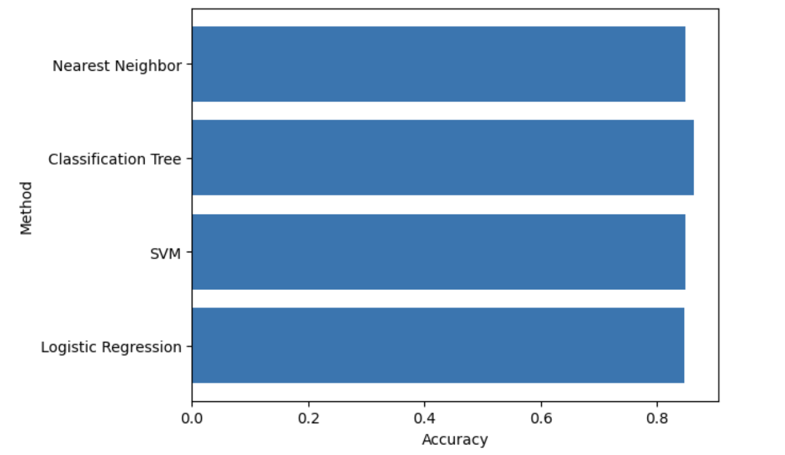
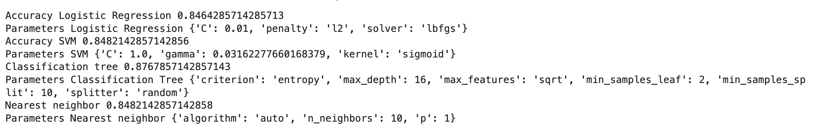
Predictive Analysis Classification Accuracy
What
Visualize the built model accuracy for all built classification models, in a bar chart
Find which model has the highest classification accuracy
Illustration
Tim Hoogenboom | IBM Data Science Capstone | May 5, 2025 | 37
Notes:
, etcC

Slide 38

Predictive Analysis Confusion Matrix
What
Show the confusion matrix of the best performing model with an explanation
Illustration
The confusion matrix for the decision tree classifier shows that the classifier can distinguish between the different classes.
Major problem is false positives →
Incorrectly predicting successful landing, whereas the actual landing was unsuccesfull
Tim Hoogenboom | IBM Data Science Capstone | May 5, 2025 | 38
Notes:
, etcC

Slide 39
Capstone Assignment Conclusions
Data visualization The higher the number of fights the greater the chance of a successful Launch_Outcome
Data visualization Over the years the success rates increases (ed: probably due to lessons learned over time)
Data visualization Orbits (ES-L1, GEO, HEO) SSO, VLEO have the highest average success in Launch_Outcome, however for the Orbits () only 1 flight was executed.
Data visualization Over the years the success rates increased
Dashboarding Kenney Space Centre (KSC) LC-39A had the most successful launches [76.9%] of all launch sites
Predictive Analysis The ML model Decision Tree Classifier has the highest accuracy score [87.7%], but still has weakness by incorrectly predicting successful landing, whereas the actual landing was unsuccessful in 3 out of 18 cases.
Tim Hoogenboom | IBM Data Science Capstone | May 5, 2025 | 39
Notes:
, etcC

Slide 40

Conclusions
Point 1
Point 2
Point 3
Point 4
…

Slide 41
Appendix
Include any relevant assets like Python code snippets, SQL queries, charts, Notebook outputs, or data sets that you may have created during this project

Slide 42

Section 4

Slide 43

Section 5

Slide 44


